Slide 1
Sponsorship & Social Media for Clubs
Swimming WA Club Conference
9th October 2021
Dr Ashlee Morgan
School of Business and Law
Edith Cowan University
a.morgan@ecu.edu.au

Slide 2
Who considers themselves to be creative?

Slide 3
What is a brand?
American Marketing Association defines it as…
“A brand is a name, term, design, symbol or any other feature that identifies one seller’s goods or service as distinct from those of other sellers.”
www.ama.org

Slide 4
From Trademarks to Lovemarks!
Your ‘brand’ truly exists only in someone’s mind.
Building a brand is about:
the hearts (how people feel about a brand),
the minds (how people think about it) and,
the actions (how people behave towards a brand).
Lovemarks command both respect and love.

Slide 5
What is a Club Brand?
The communication of the club’s uniqueness: it’s their story, their style, their values, and of course, their sport-related pursuits and activities!
“The highlight that sticks out is going through the process of identifying my brand. It has allowed me to create a message that I truly believe in and has opened up some incredible new opportunities for me to leverage it.”
- Glenn Paul (professional golfer)

Slide 6
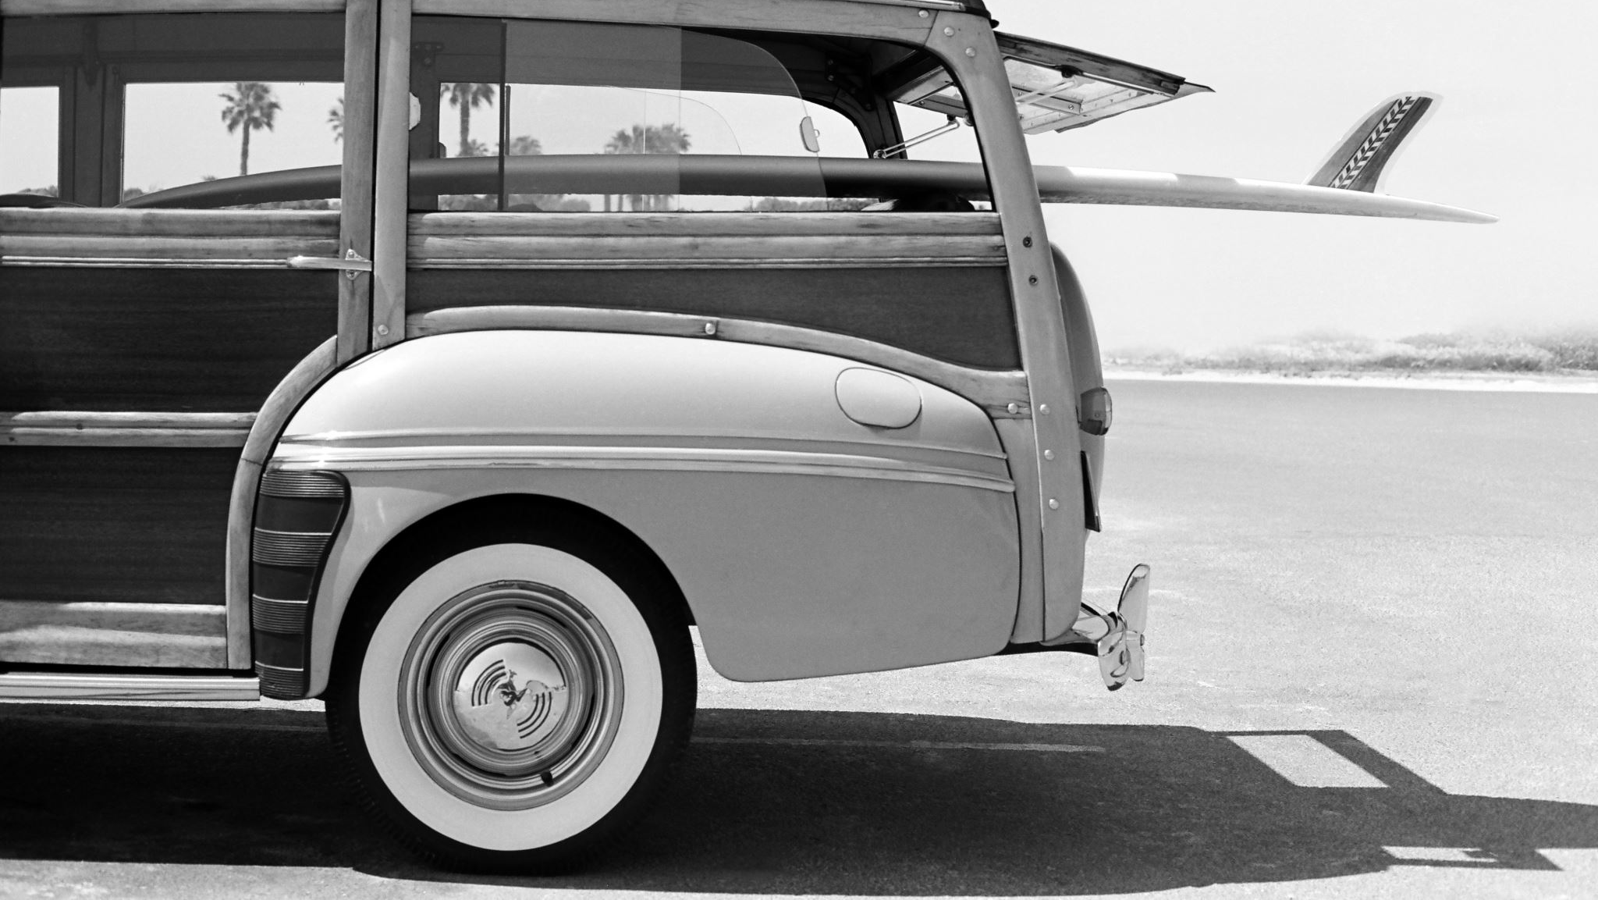
What is your Club’s Brand?

Slide 7
identity
defining
brand
Write down 5 adjectives that describe your club’s personality the most (1 per Post-it)

Slide 8
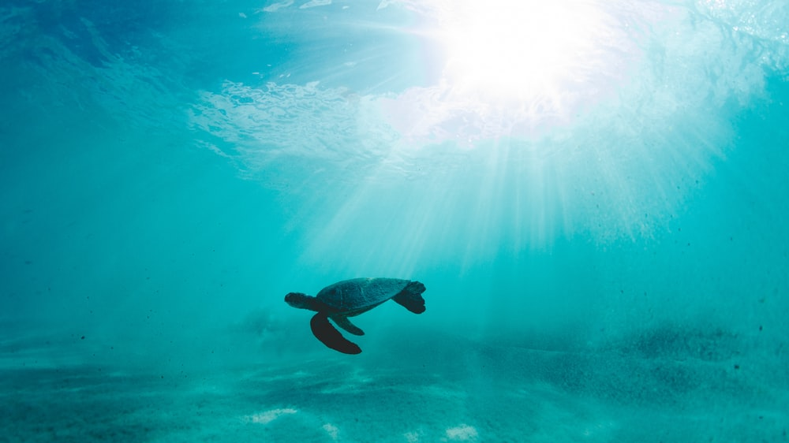
Your uniqueness is key, and your brand is your greatest asset

Slide 9
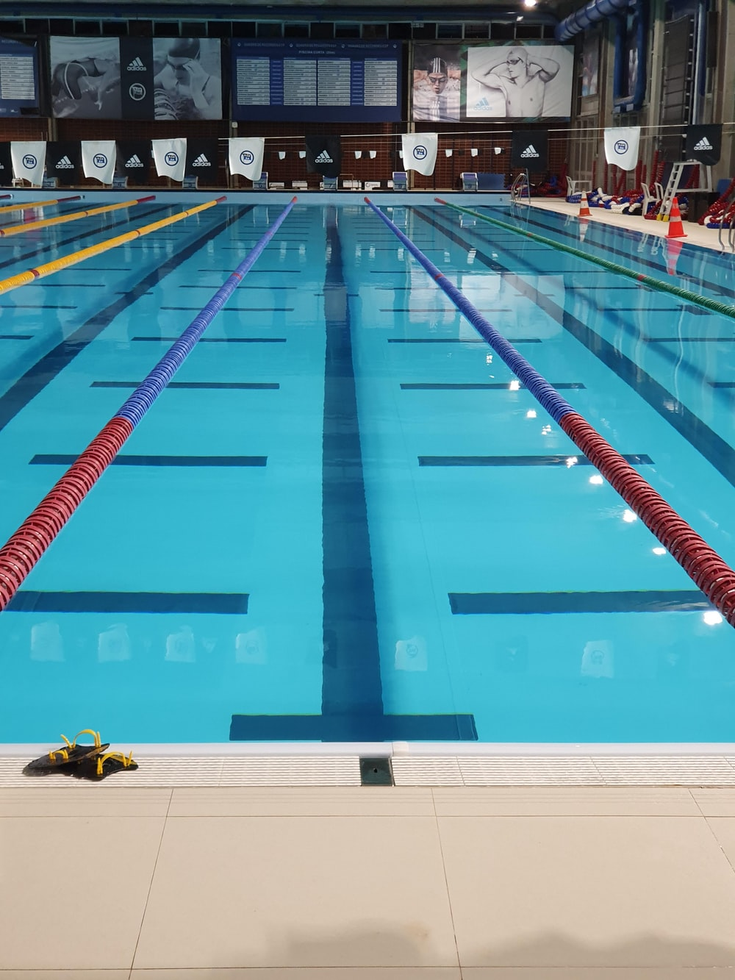
What does ‘sponsorship’ mean to you?
It is an investment in cash or kind, in an activity, in return for access to the exploitable commercial potential associated with that activity.
Sponsors pay for the ‘right to associate’ + need a ROI.
Sponsors want to link with the excitement of your brand and emotional attachment your members, fans, community have to your brand.

Slide 10
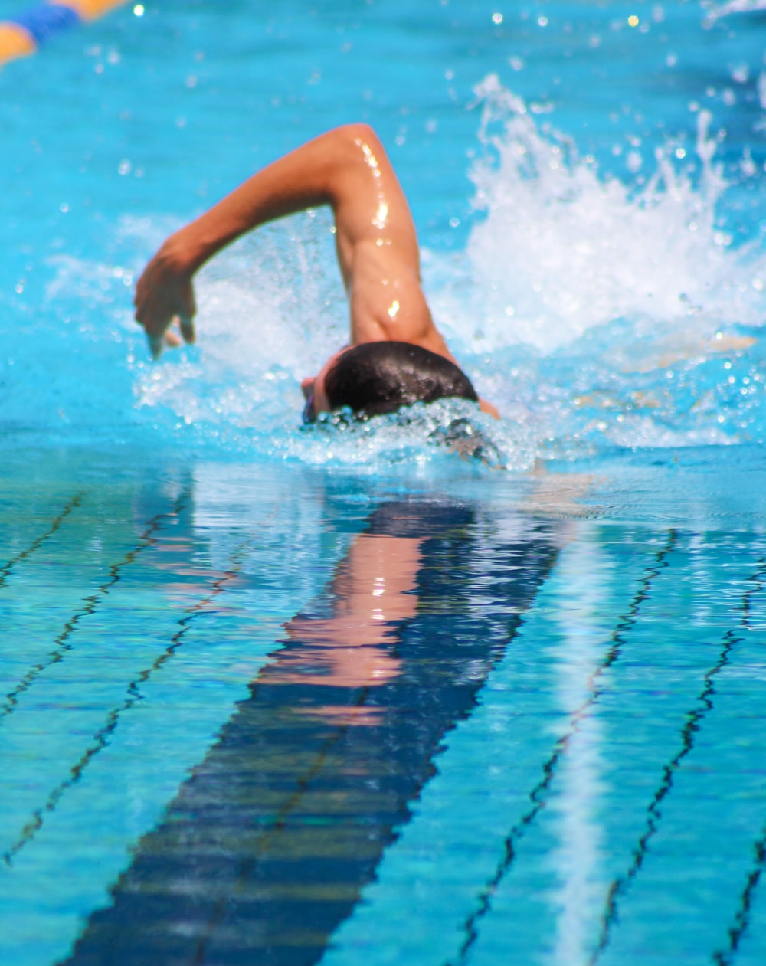
The Sponsor ‘Hit List’
Match target market (audience) and at least another brand characteristic.
Match attributes for relevance/values.
Both parties should share objectives and objectives should be mutually complementary.
What might a sponsor being trying to achieve and what do you have that could add value for all parties?
Notes:
10

Slide 11
Creative Examples
Local fete: provide email address, enter ‘Speed of Kick’ game, chance to win.
Club provided stretching and mobility sessions and ‘tips’ for truck drivers and sedentary office workers.
Recruitment company donate to a homeless shelter. Baseball club volunteer and film a video interviewing the players.

Slide 12
How to Write a Sponsorship Proposal
Less is more
It is all about them
Be honest

Slide 13
Never Send an Unsolicited Club Sponsorship Proposal
HOT TIP…

Slide 14
Proposal Tips
Stay true to the Club’s values, don’t try to be something you’re not.
Keep it clear, concise, and honest.
Write it and edit it. Get a couple of other people to review it and fine tune with you.
Your goal is to get them to read the whole document, as quickly and easily as possible.
Use great photos!
Write a generic proposal and then tailor it to key potential sponsors.

Slide 15
Submitting a Sponsorship Proposal

Slide 16
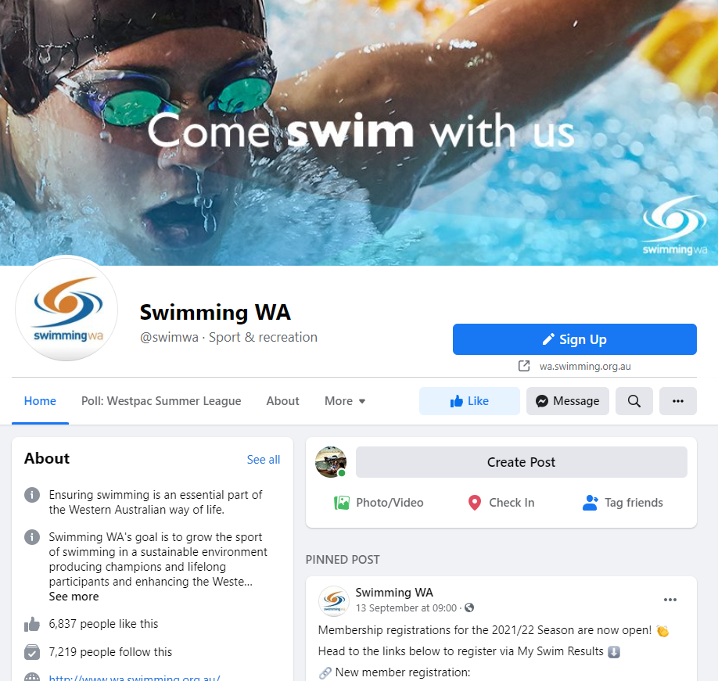
Social Media

Slide 17
The 4E Framework
EXCITE
ENGAGE
EDUCATE
EXPERIENCE

Slide 18
The Power of Socials
Size doesn’t matter – all clubs should use socials to achieve your communication goals, e.g.:
Increasing the size of the club’s audience
Creating depth within these relationships with sense of belonging
Engaging future participants
Supporting the delivery of club objectives

Slide 19
3 Easy Hacks
Everybody loves a good story – Storytelling is the ultimate key to social media success. By telling a story, you build a sense of belonging and a relationship with your audience. As that relationship builds, so does engagement!
Events – Use Facebook events to ensure all members know about upcoming social and footy-related events. Make sure to make appropriate events public on Facebook so members can tag their mates and share it with others outside the club.
Video – It is the most engaging content!

Slide 20
Scheduling

Slide 21
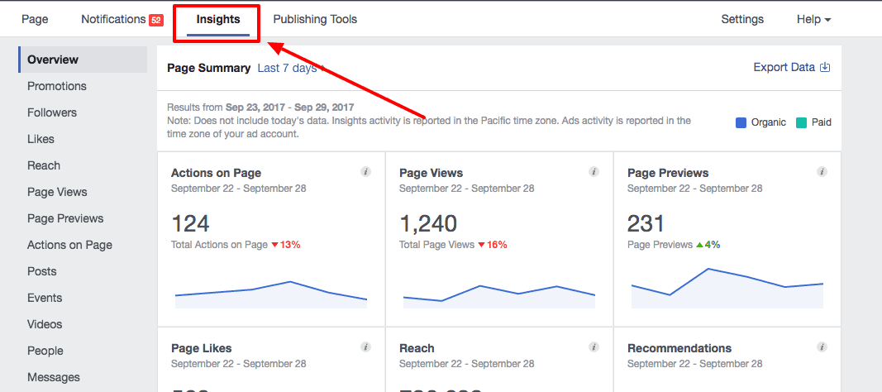
Social Media Insights

Slide 22
Thank you
Ashlee Morgan
a.morgan@ecu.edu.au

